Slide 1
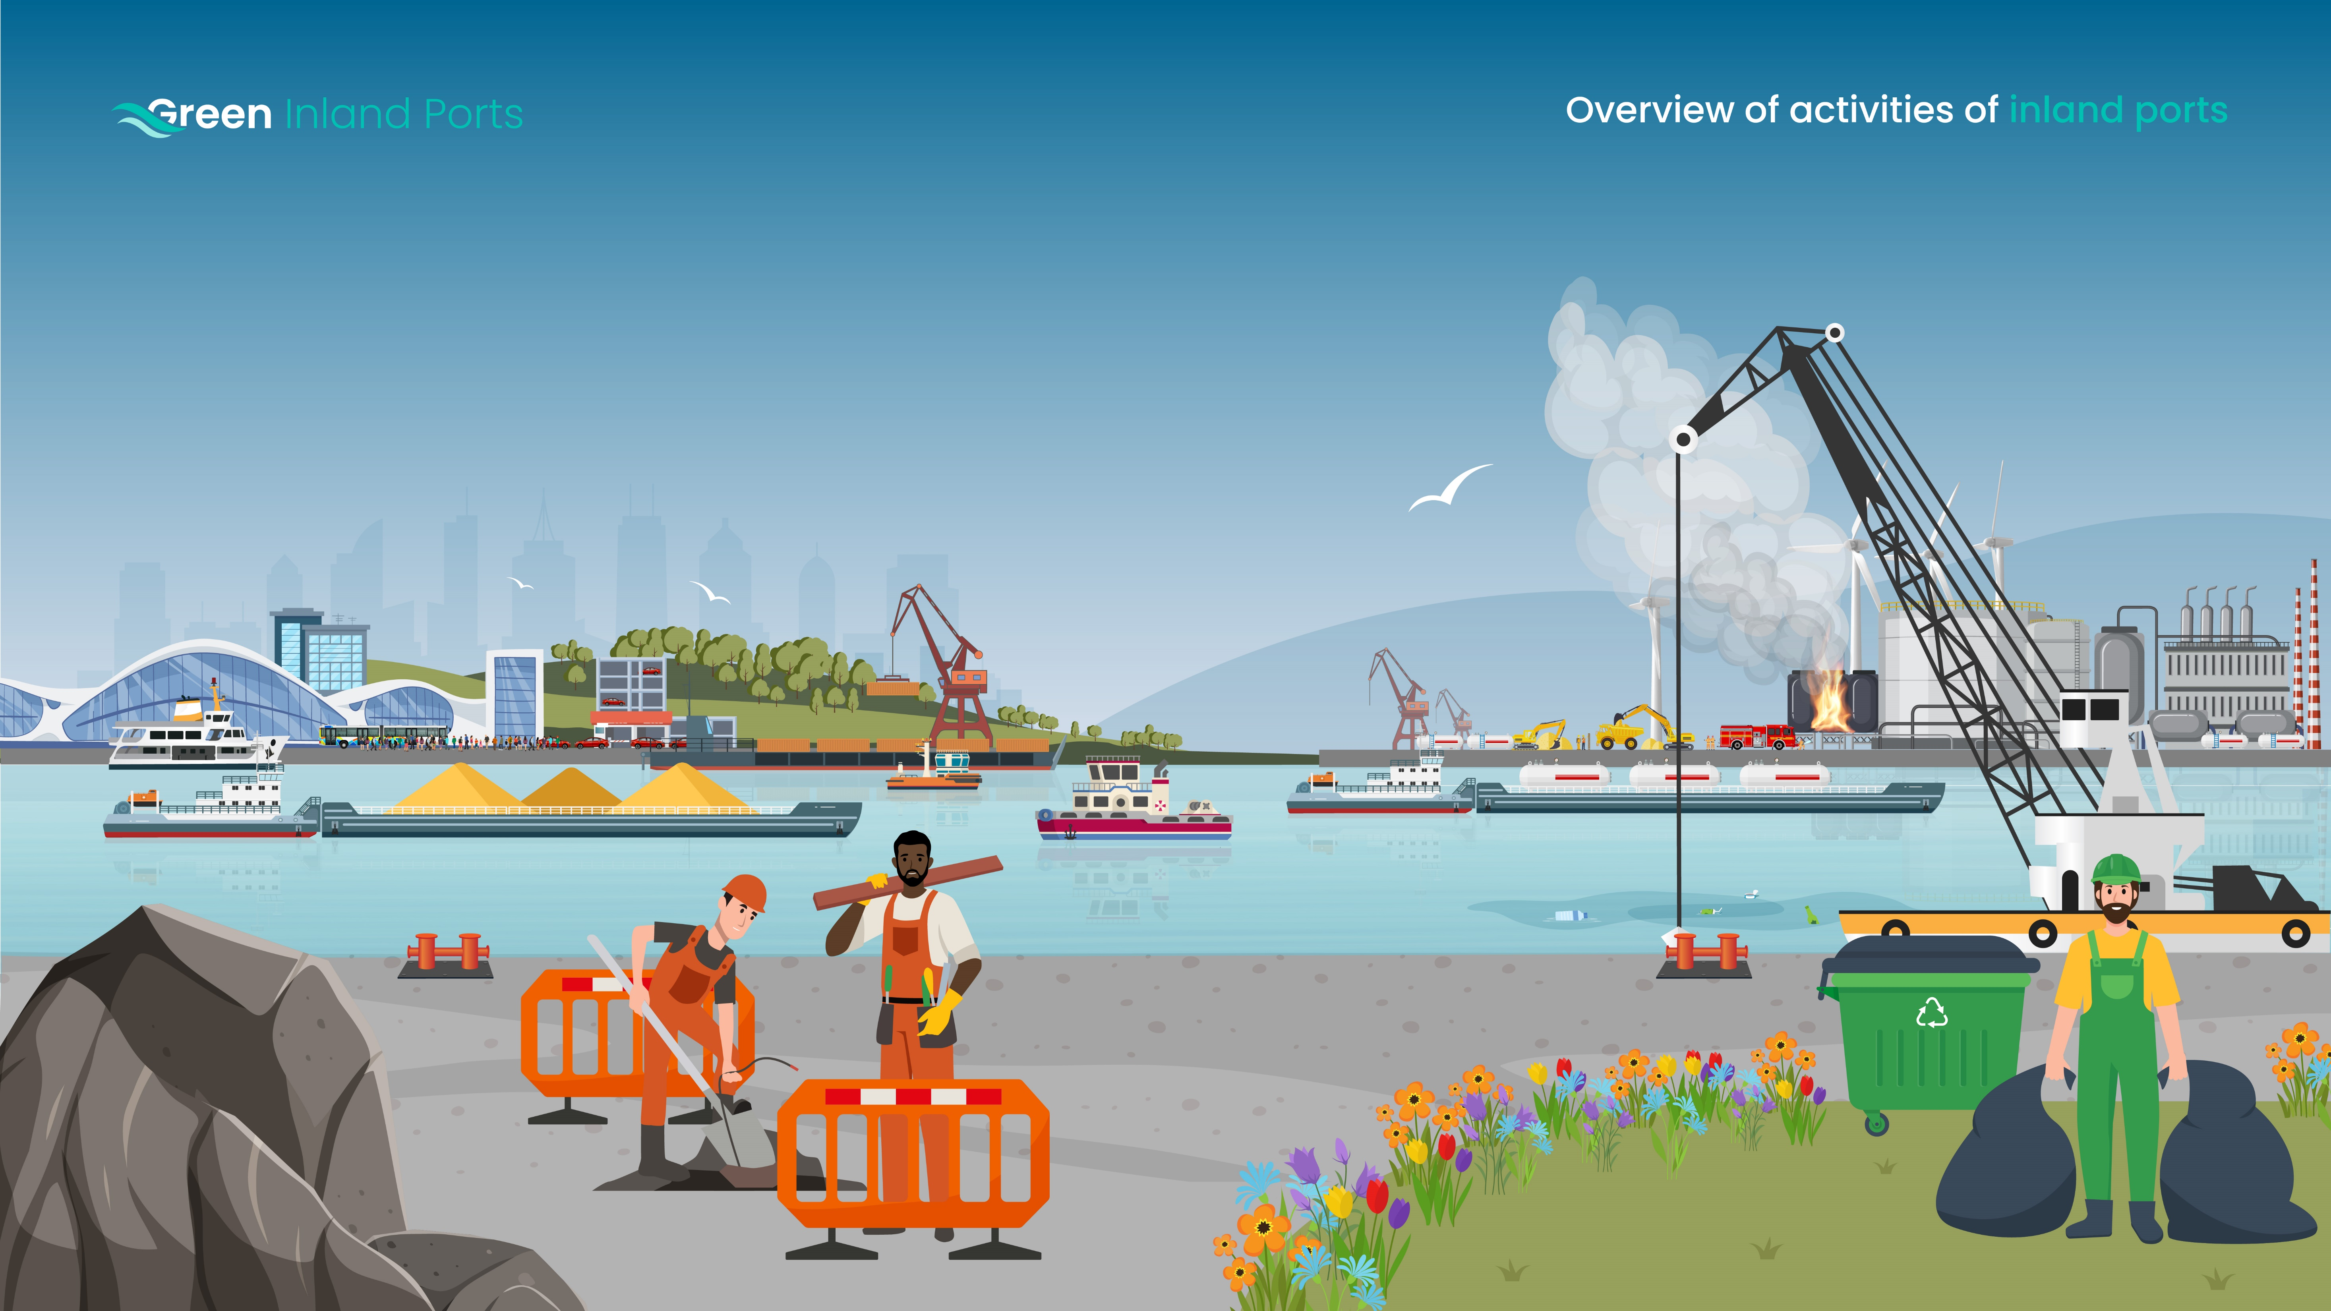
Port-owned vessels
Energy infrastructure
Work boats, cleaning boats, tugs…
(at berth, moving through harbour)
Power plants, incinerators
Commuting
Cargo and passengers
Office and port employee commuting
(by car/train/bus/other)
Cargo (loading, unloading, transportation by truck/train, storage)
Passengers (transport to/from/within harbor)
Incidents
e.g. fires
3rd parties
Independently owned vessels passing through
industry (refinery, companies...) Waste treatment plants
Maintenance
Waterways (dredging), roads (paving), buildings,
Vehicles, vessels (at berth or in port yard)
Waste treatment
Collection, combustion, gas freeing…

Slide 2
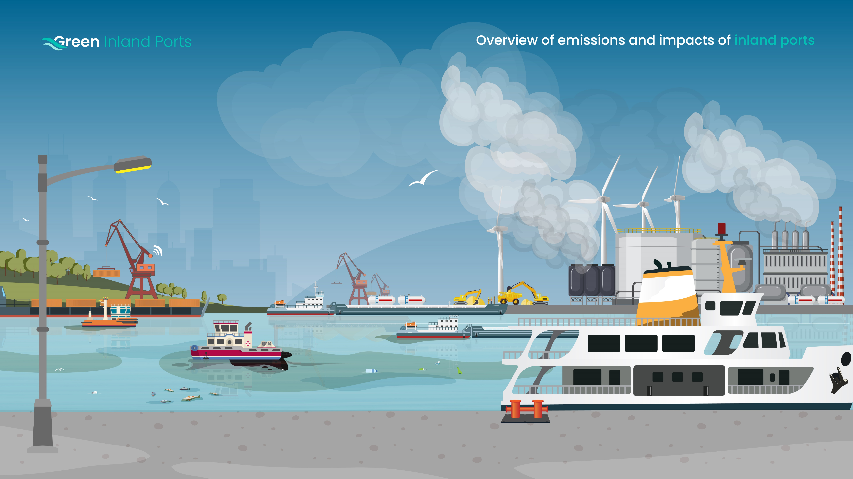
Impacts:
Contributions to climate change
Impacts:
Effect on terrestrial habitats
Emissions: Air
CO2, Nox, Particulate matter
Emissions: Light
Light pollution
Impacts:
Effects on human health
Impacts:
Contributions to resource scarcity
Emissions: Sound
(examples aanvullen)
Emissions: Soil
Emissions: Water
Chemical spills. Dredging can produce (contaminated) soil waste
Oil and chemical spills (PFAS)
Impacts:
Effect on marine environment

Slide 3
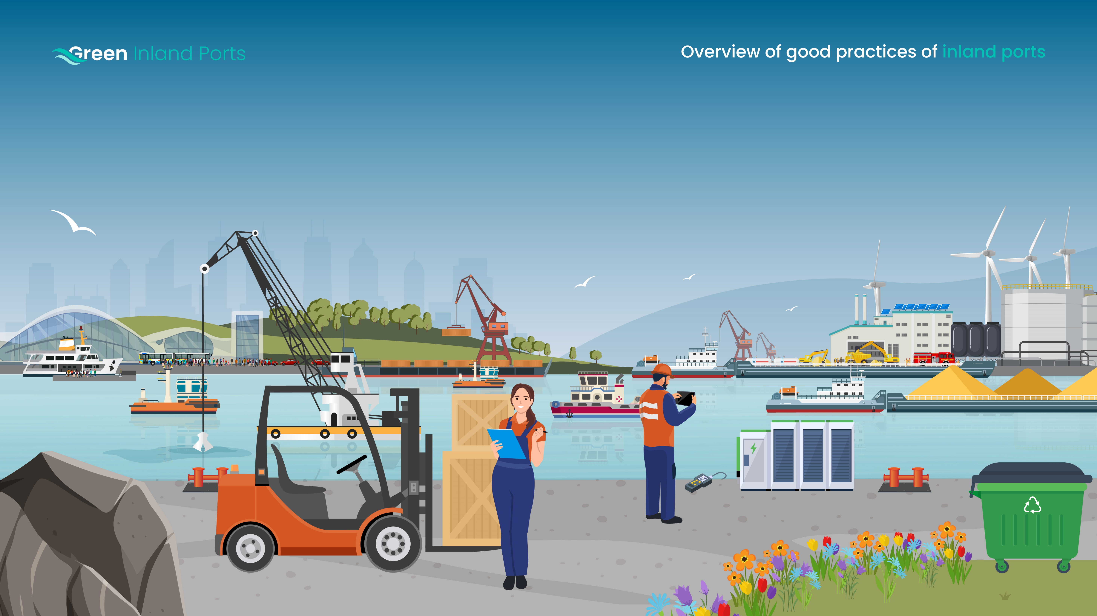
Port-owned vessels
Offices and employees
Energy infrastructure
Good practice
Reduced emission
Good practice
Reduced emission
Good practice
Reduced emission
Content here
Content here
Content here
Content here
free deposit for bilgewater Energy supply: Solar panels, Wind
Electrification: of fork lifts, cranes…
Content here
Cargo and passengers
Incidents
Good practice
Reduced emission
Good practice
Reduced emission
Promote public transport
Content here
Content here
Content here
3rd parties
Maintenance
Waste
Good practice
Reduced emission
Good practice
Reduced emission
Good practice
Reduced emission
Content here
Content here
Content here
Content here
free deposit for bilgewater
Content here

